Slide 1
KISS Workshop on the “Science and Enabling Technologies for the Exploration of the Interstellar Medium” Post Workshop: Summary of Action Items
Leon Alkalai, Ed Stone, Lou Friedman
Co-Organizers

Slide 2
Plan Towards Workshop #2 January 12th, 2015
ALL: Next KISS workshop January 12th, 2015; mark your calendars; book your travel
Assume 3 full days.
ALL: review Action Item list (in this presentation) and provide any comments back to Leon Alkalai cc: Nitin Arora.
Science Team: Goals, Objectives due by November 17th, 2014
Mission Team: Two Team X studies: Early December 2014
Technology Team: updated briefings at the workshop January 12th, 2015
Emerging Capabilities Team: present results at workshop January 12th, 2015
ALL: KISS Final Study Report due March 15th, 2015
ALL: Proposal for Technology Development Plan to KISS, April 1st, 2015
ALL: KISS funding opportunity, October 1st, 2015

Slide 3
Overview of Action Items
Science
STM: Science Objectives, Measurements and Feasibility Assessment
Science / measurement Interactive Tool
Two Team X studies
1) 100 AU in < 10 years; grand tour KBO + Centaurs; 2) Swarm of small probes into the LISM
Technology Assessment
Miniaturization: Impact of Cubesats on the future of Space Exploration; instruments
Propulsion: Solar Sails (dual use, material testing, new deployment)
Communications: Optical or RF communication systems
Thermal management: thermal shield for perihelion burn
Avionics: Reliability, miniaturization, re-configurability using FPGA
Engineering Feasibility Study
1) Gravitational lensing; 2) Beamed energy; 3) Solar Sail scaling and perihelion burn
Public Outreach
Formulate Plan; Public engagement; Explore avenue for non-governmental funds
Develop Strategy to reach/influence Decadal Surveys

Slide 4
AI-1: Science action item team leads
In-Situ Science:
Lead: Gary Zank
Members: Merav Opher, Dick Mewaldt, Seth Redfield, Ralph McNutt, Paul Goldsmith, Jamie Rankin, Elena P., Adam Michael
Topics: Plasma ISM, Neutral, Magnetic Field, Turbulence, Dust, ENA and backscatter Lyman-alpha
KB Science, Zodiacal Dust:
Lead: Mike Brown
Members: Mark Swain, Mike Werner, Mike Shao
Topics: KBOs, Dust detection and characterization, Understand utility of KB in terms of planetary formation
Astrometry, Astrophysics:
Lead: Mike Shao
Members: Mark Swain, Slava Turyshev, Claudio Maccone, Mike Werner, Jared Males, Seth Redfield, Freeman Dyson
Topics: Extra galactic parallaxes, masses of asteroids, centaurs, Exoplanets search, orphan planets search

Slide 5
AI-1: Science action item: each team
Define:
Science goals
STM: Science Traceability Matrix approach
Quantify science objectives:
what is the value of science?
additional description requirements, how you meet them?
Measurements and instrument requirements:
Miniaturization
Key performance parameters and system requirements
Due date:
November 17th, 2014
Will be reviewed at workshop January 12th, 2015

Slide 6
AI-1: Science Visualization Tool
Lead: Nitin Arora, Jamie, Elena, etc.
Show log scale, linear scale ( to and from )
Show Voyager and other spacecraft
Polar plot (top view) showing various local ISM regions
Highlight various science disciplines (planetary, Heliophysics, astrophysics etc.)
Include interactive behavior
Understand and develop educational aspects of the tool
Illustrate KBOs in some scientific detail
Combined science case: Heliophysics, Astrophysics, Planetary Science
Follow up with Ellan Stofan, NASA CS
3D navigation

Slide 7
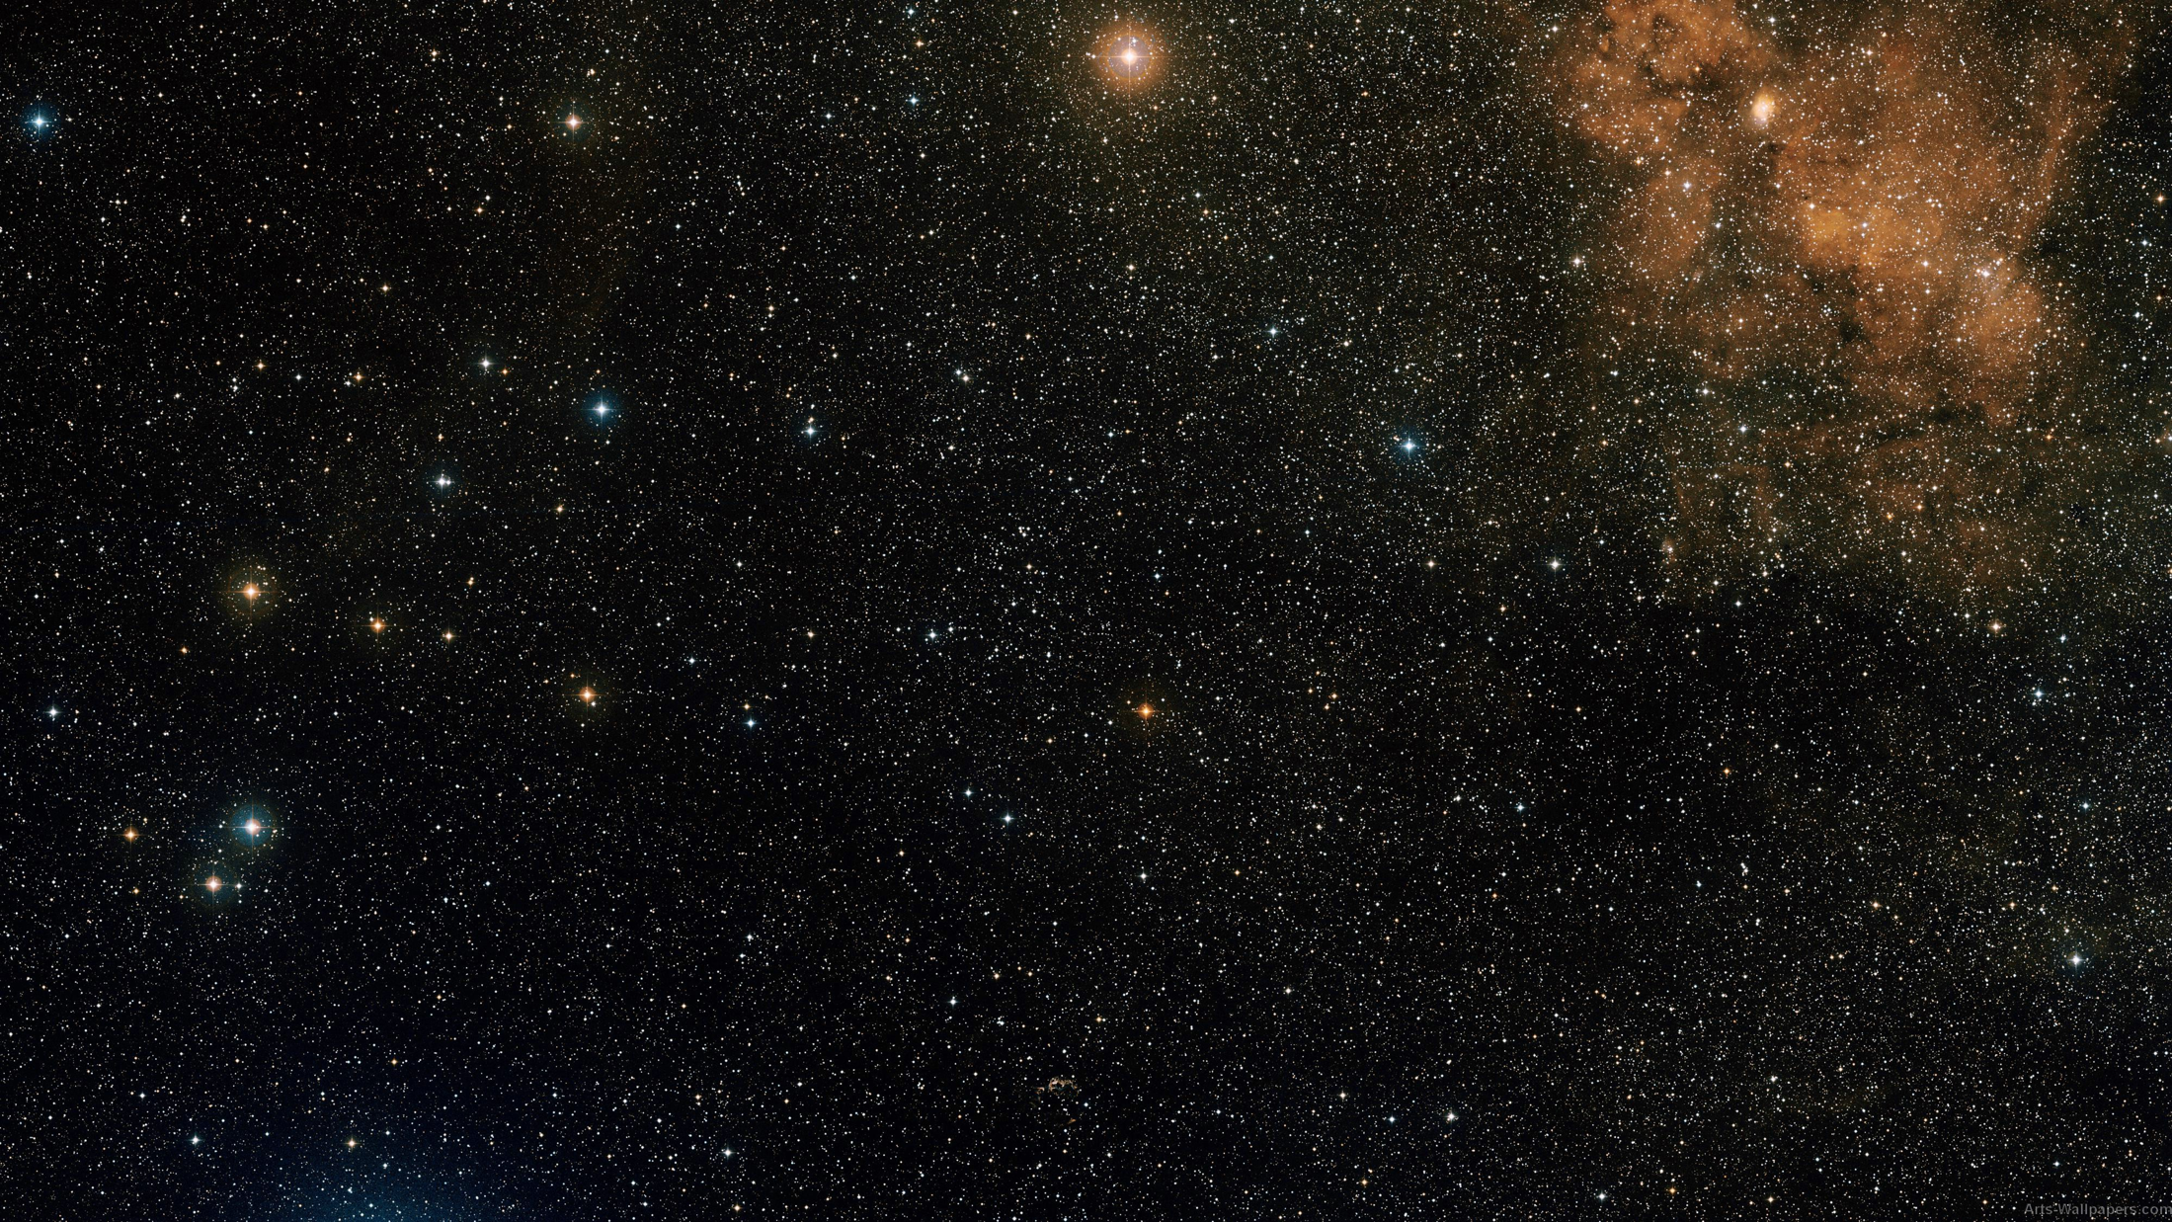
AI-1: Science Visualization Tool (draft)
Interstellar wind
Solar Gravitational lens
Distance (AU)
Investigate possibility of LOG scale

Slide 8
AI-1: Science Visualization Tool (draft)
Interstellar wind
Solar Gravitational lens, CMB
Distance (AU)
Investigate possibility of LOG scale

Slide 9
AI-2: Team-X Mission Study 1
100 AU in ~10 years
Assume SLS lift capability
Investigate Trajectory options: Jupiter flyby to achieve perihelion; Direct Jupiter flyby escape
Analogy to Grand tour: Centaur and KBO flyby
Critical event analysis: Perihelion burn:
Cruise phase science team: Mark Swain, Mike Shao, Seth, Jarred, Mike W., Phil Lubin
Credible design for a 2-3 stage solid (SRM) with heat shield
Thermal Protection System scaling

Slide 10
AI-2: Team-X Mission Study 2
Members: Paullette, Dick M., Merav Opher, Manan, Darrell, Jamie, Freeman, Leon, Nitin, Adam
Swarm of probes to cross the heliopause
How small can you make the probe?
How many?
How fast can they escape ?
Miniaturization ‘revolution’
CubeSat analogy for interstellar missions

Slide 11
AI-2: Possible Tech Demo missions
Solar Reflector to simulate Low Perihelion
Test solar heat shield
Test SRM inside the shield at elevated temperatures
Solar sail material testing
Increase sail loading (g/m²) and sail specific weight
Packaging, origami deployment
Part of the test in Earth orbit
Some ground testing possible (France)
Small Spacecraft Lifetime Mission
Long distance Com.
Kuiper Belt and beyond ( target 100 AU in 10 years )
Small instruments when possible
REP
SRM at Jupiter
Hibernation
Laser-Sail / Beam propulsion Demo
Small Sail + Laser from earth or small-sat

Slide 12
AI-3: Technology Assessment Update
Miniaturization update, Rob Staehle
Update on CubeSats, integrated avionics and instruments
Propulsion, Les Johnson
Solid rocket motor lifetime qualification and near perihelion burn
Light weight, Dual use sails; Sail material testing for close solar pass
Radio Isotope based Electric Propulsion/ Low power long life Thrusters
Telecommunications, Abhi Biswas
Deployable / Inflatables antennas; Sail as an antenna; Solid state Optical comm.
Thermal / Shield, Ralph McNutt
Solar heat shield (test Carbon-Carbon shield with new configurations)
Magnetic and Electro static Shielding; Thermal management
Avionics: G&NC, Reliability and Resilience, Leon Alkalai
FPGAs, Hibernation, Wafer scale systems; Systems on a chip; Radiation tolerance

Slide 13
AI-4: Engineering Feasibility Study: Beamed Energy Engineering Study
Members: Phil Lubin, Lou Friedman
Provide a reasonable engineering implementation concept
Propose a technology demonstration concept
Present results at the January workshop

Slide 14
AI-4: Engineering Feasibility Study: Gravitational Lensing
Members: Jared, Slava, Caludio, Mike (Shao), Mark Swain
Define science objectives?
Can it be done and how?
What would the image of the Earth look like?
Identify other engineering constraints.

Slide 15
AI-4: Engineering Feasibility Study Solar Sail Trade Study
Members: Lou, Les, Darren, Nathan Barnes, Manan
How close to the Sun can you go?
What is the best sail density or sail specific weight possible?
What would it take to design a 150 m (radius) Sail ? How much would the sail + sail sub-system weigh ?
Dual use question: other uses of Solar Sail ?

Slide 16
AI-5: Public Outreach Plan
Study lead: Mae Jemison, Lou Friedman, Leon Alkalai
Public outreach: crossing of Voyager, Scientific American, National Geographic, NPR
Work with JPL Blaine Baggett to come up with ideas,
Minute Physics outreach – a series of lectures on youtube
Target and work with existing groups like 100YSS program and others
Ideas for Crowdsourcing a first mission or tech demo mission
Present ideas at the January workshop

Slide 17
AI-6: Develop a plan to (inform) Influence the Decadal Surveys
Study Lead: Paul Goldsmith, Mike Werner
Target Decadal Surveys:
Astrophysics
Planetary
Heliophysics

Slide 18
AI-6: Grand Vision of a Grand Challenge Interstellar Exploration Program
Technology Demonstration, Science Discovery
Technology Demonstration Missions
1 – 10 AU
Small Explorers LISM and Heliosphere
Multi-Probes
5 – 100 AU
Medium Scale Missions
200 – 300 AU
Large Scale Missions
500 - 600 AU
Thousand AU challenge
1000 AU
50 years
Advanced Studies, Technology Maturation, Technology Development

